Slide 1
DENTAL MANAGEMENT SOFTWARE
Dental Management Software That Helps You Take The Transformative Step Towards Making Your Clinic Management More Efficient.

Slide 2
WHY THE GEMINI ?
MANAGEMENT ASPECT
Headquartered in Ahmedabad, India, The Gemini is a leading Global Enterprise Software Provider with a reputation for Innovative Products and Outstanding Services. The company provides enterprise software solutions to multiple verticals, including Healthcare, Education, Corporate Houses, Public sector across India, Asia, UK, UAE & US.
High-quality and cost-effective services
Diverse teams of highly qualified professionals
Proactive project management
Latest software and technologies
Stable marquee clients & strong positive references
Capabilities to meet clients’ needs
One-stop-shop for all IT needs
Proven infrastructure to provide 24x7 supports globally.

Slide 3
MISSION
VISION
Our Mission is to provide a top quality development service to achieve client's business objective.
To become 'No. 1' in innovative business solutions and ERP solutions.
www.thegemini.co.in

Slide 4
INTRODUCTION
It is a comprehensive, user friendly & integrated information system designed to manage the Administrative, Financial & Clinical aspects of a Hospital and its service processing. Web based Dental Hospital Information Management System is an ERP suite of software modules to computerize any large scale hospital and connected clinics and its branches. The information is available anytime, anywhere. There are plenty of exhaustive modules available in The Gemini Web Dental ERP , which makes it User friendly, Highly versatile, Quick installable, Completely Database driven, Centralized Database, Hospital Information Management System ERP software available in the market today
Our Software for dentists and dental practice management covers all aspect of dentist related queries. Our modern dental software includes appointment scheduling, imaging, and dental charting. Our dental Practice Management software specifically designed for today's busy Dental clinics & Dental Hospitals. Our dental software helps for appointment scheduling, billing management.
www.thegemini.co.in

Slide 5
MODULES

Slide 6
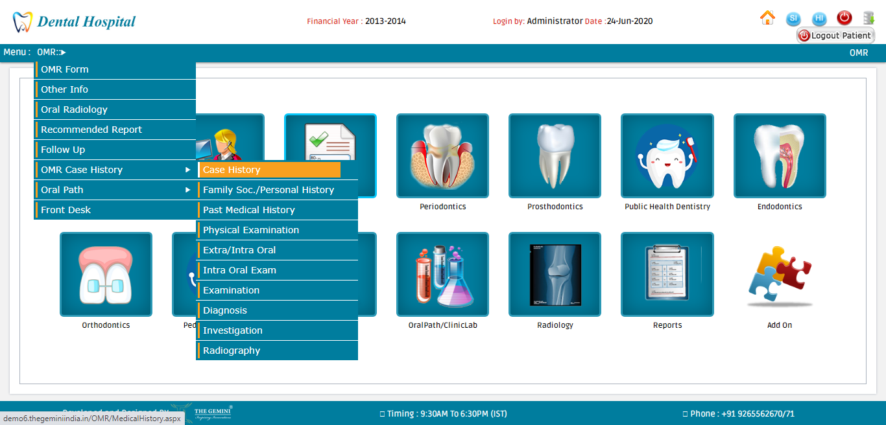

Slide 7
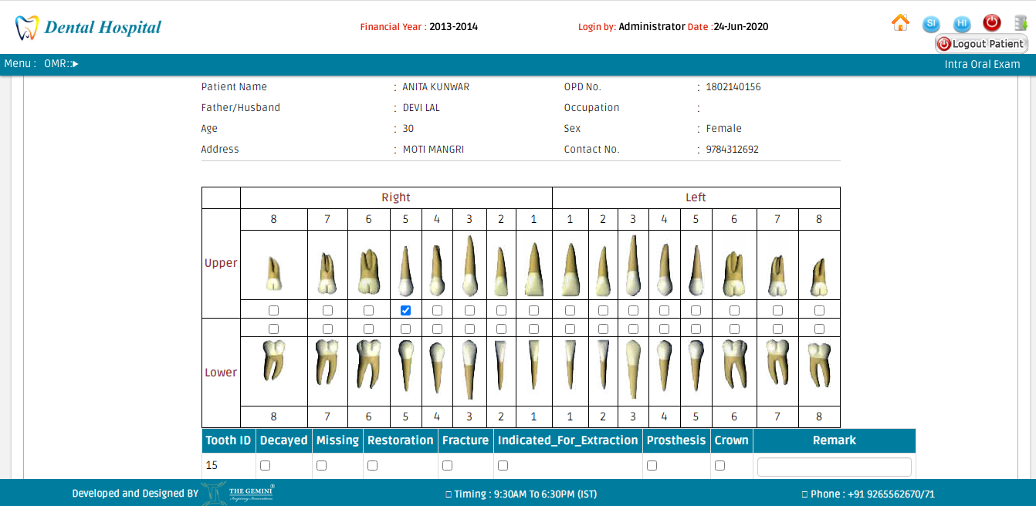

Slide 8
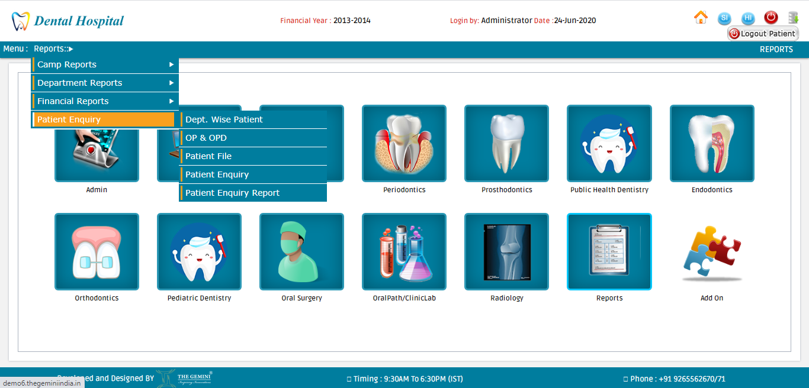

Slide 9
KEY DIFFERENTIATORS & ADVANTAGES
Real-time branch Clinic/Hospital information's.
Electronic case transfer between Departments.
Consolidate Reports.
Customized package.
Organized Stock and Finance Management.
Secure system with user access control.
Very User friendly
Complete package with optional modules
SMS, Patient Card, Prescription, Bills
Electronic dental records
Automatic backup
Total Paper Free dental clinic
Detailed billing System for better accounting
Easy search for retrieving information stored relating to patient, staff, diagnosis, treatment, billing etc.
Separate module for Each Department
3 level security (Super-admin, admin and user)
Helps build Dental Case Records with utmost ease
Maintains individual patient account ledgers for each treatment session
Tracks patient referrals and cross referrals
24/7 Support

Slide 10
SOLUTION HIGHLIGHTS
IMPROVE FUNCTIONING
Our Dental Software was designed to ‘unify and subsequently nullify’ all the grey areas in administrative practices and synchronize Hospital and Patient Management with ease.
TREATMENT AND REVENUE MONITORING
Category wise patient treatment can be easily tracked down with prescription and admissions details. Not just this, step-by-step treatment can be monitored via user id or registered contact for bill generation.
DIGITAL MEDICAL RECORDS
To save paper and avoid loss of paper records; this software tracks everything digitally. Digital Medical Records are the new ways to beat the challenges in Healthcare Industry.
The Gemini is committed to serving the best possible Healthcare IT Solutions to improve patient's experience on the whole. Our Software is easy to use and maintenance-free. We can customize and design software depending on individual requirements.
DEPARTMENTAL REFERRAL TRACKING
Dental Office Management Software efficiently streamlines the New and Existing Patients to streamline sharing patient records in relevant departments.
www.thegemini.co.in

Slide 11
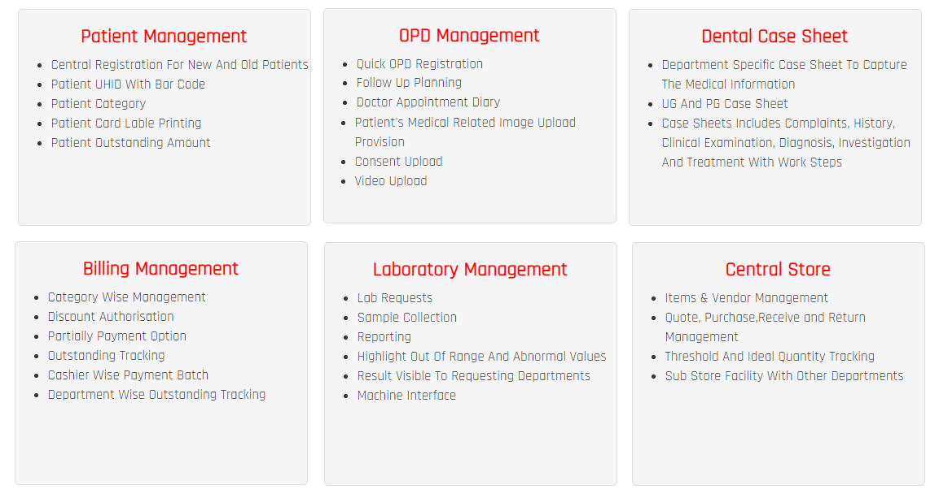

Slide 12
HOW IT WORKS ?
www.thegemini.co.in

Slide 13
WHO CAN USE OUR DENTAL SOFTWARE ?
CLINICS
HOSPITALS & MEDICAL CENTRE’S
DENTAL MEDICAL COLLEGES
www.thegemini.co.in

Slide 14
LOCATIONS
DEVELOPMENT CELL:
TECHNICAL SUPPORT:
Ahmedabad, Ajmer, Kolkata
Udaipur, Mumbai, Bangalore, Noida, Pune, Silvassa
BUSINESS ADDRESS :
THE GEMINI PARTNER :
Berlin, Germany
Nigeria, Kenya, Uganda, UAE, Trinidad
www.thegemini.co.in

Slide 15
CONTACT
Just let us know your business requirements we will arrange a meeting with our Dental Management System Software Certified Consultant to understand more about your business and its requirements related to Dental Software Customizations, Implementation, Training & Support Services.
Call +91 9265562676
Email : consultants@thegemini.co.in
For More Details Visit: www.thegemini.co.in
www.thegemini.co.in

Slide 16
THANKS!

